Slide 1


The GIVEnTRUST Project
Donations become transparent

Slide 2


The Technology
FinTech APIs (Payments & Loyalty Program
Decision Making Models
Blockchain Traceability & Integrity
The Revenue Model
5% commission over transaction
0% commission on donation
Extra reports for insurance

Slide 3

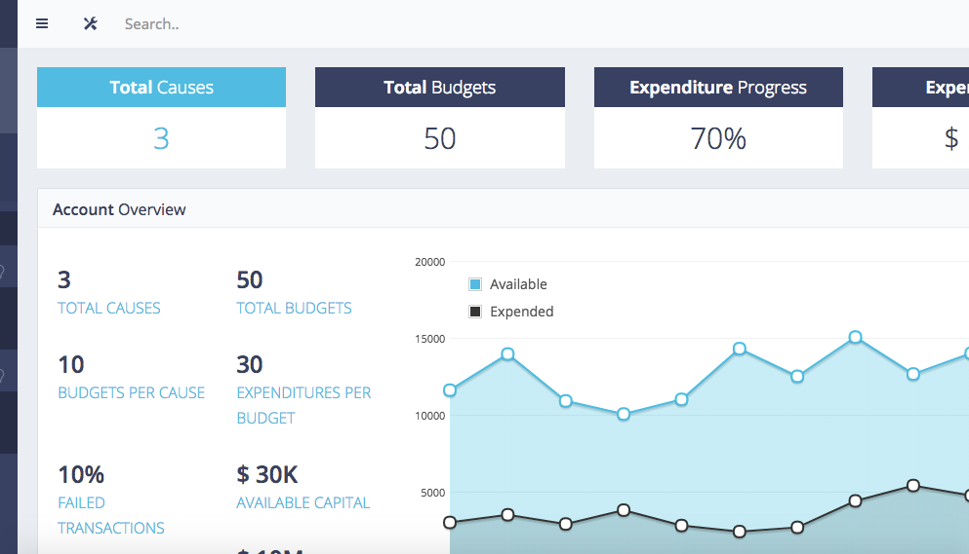

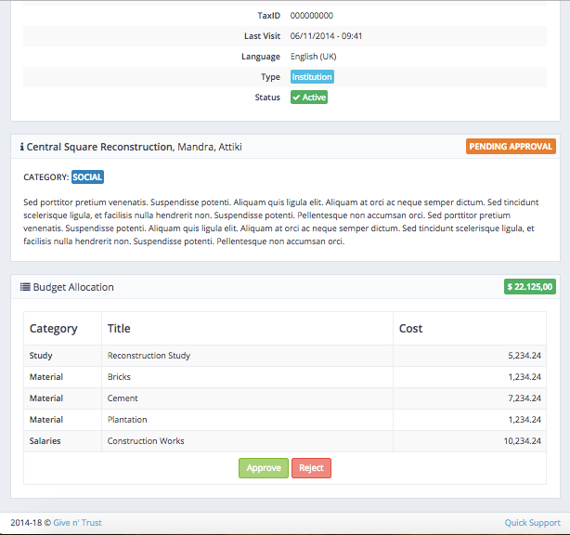

1. Verify beneficiaries
2. Create a verified donation cause
3. Donate → Virtual Currency
4. Purchase → Consume VC ONLY on approved products

Slide 4
Economic & Social Impact
GIVEnTRUST
Positive Financial Assessment
Collaborating Business
Donor
New customers, Increase revenues
E-Goverment
Beneficiary
Transparency, Maximize donation efficiency
Loyalty, Social Impact, Transparency in payments
Instant need satisfaction

Slide 5
The Big and the Bigger Picture.
01
02
03
Public Budget
National Strategic Reference Framework
Micro Lending / Micro Funding

Slide 6







Demetris Gerogiannis
Nikki Karali

Slide 7










Christos Nikoloudis
Katerina Mamalougka

Slide 8
www.giventrust.org
THANK YOU

Slide 9
The
Competition
 |  | Automation | General Applicability | Holisticity | Trust | Low Price
 |  | 😊 | 😊 | 😊 | 😊 | 😊
 |  | 😊 | 😊 | 😡 | 😊 | 😊
 |  | 😊 | 😊 | 😊 | 😡 | 😡
 |  | 😊 | 😡 | 😊 | 😊 | 😡
Banks’ escrow systems |  | 😡 | 😊 | 😊 | 😡 | 😡

Slide 10
Total Initial Investment

Slide 11
Financial Analysis
Total Operational Costs | 142.333 | 749.873 | 2.494.161 | 4.557.813
Free Cash Flow | -47.742 | 272.727 | 2.224.762 | 6.088.813
Total Revenues | 132.287 | 1.058.833 | 4.753.693 | 10.679.932
79€
22€
13,5€
Α/Α | Changes | Initial Investment Cost | Total Revenues | Interest Rate Loan | NPV | IRR
1 | Interest Rate Decrease | - | - | 7,50% | 549.867 | 55,32%
2 | Interest Rate Increase | - | - | 9,50% | 544.687 | 54,72%
3 | -10% | 142.190 | - | - | 576.522 | 60,14%
4 | 10% | 173.788 | - | - | 518.032 | 50,51%
5 | -10% | - | Cash Flow | - | 325.735 | 40,70%
6 | 10% | - | Cash Flow | - | 768.819 | 66,87%
7 | -10% & +10% & 7,5% | 142.190 | Cash Flow | 7,50% | 800.395 | 72,67%
8 | +10% & -10% & 9,5% | 173.788 | Cash Flow | 9,50% | 293.641 | 36,25%

Slide 12
DCF & Sensitivity Analysis
Α/Α | Changes | Initial Investment Cost | Total Revenues | Interest Rate Loan | NPV | IRR
1 | Interest Rate Decrease | - | - | 7,50% | 1.599.867 | 55,32%
2 | Interest Rate Increase | - | - | 9,50% | 1.444.687 | 54,72%
3 | -10% | 142.190 | - | - | 576.522 | 60,14%
4 | 10% | 173.788 | - | - | 518.032 | 50,51%
5 | -10% | - | Cash Flow | - | 325.735 | 40,70%
6 | 10% | - | Cash Flow | - | 768.819 | 66,87%
7 | -10% & +10% & 7,5% | 142.190 | Cash Flow | 7,50% | 1.800.395 | 72,67%
8 | +10% & -10% & 9,5% | 173.788 | Cash Flow | 9,50% | 293.641 | 36,25%
Α/Α | Parameters | Prices
1 | Initial Investment Cost | 177.590
2 | Total Revenues | Cash Flow
3 | Interest Rate Loan | 2,50%
Α/Α | Parameters | Prices
1 | Νet Present Value (NPV) | 1.589.612
2 | Internal Rate of Return (ΙRR) | 89%

Slide 13
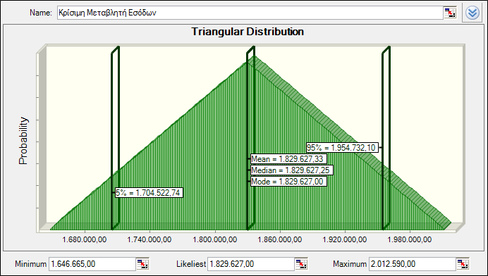
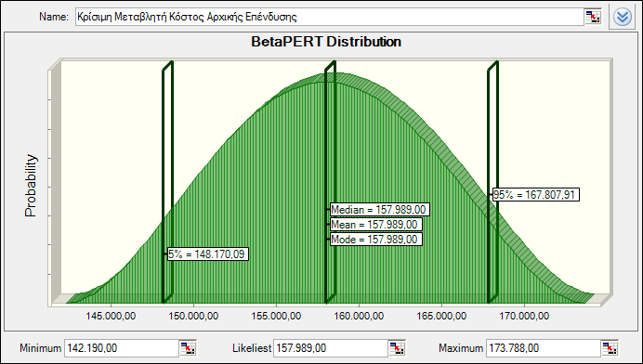
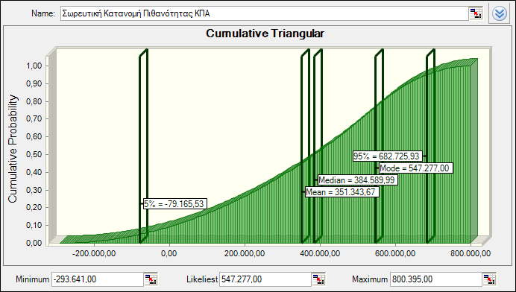
Quantitative Risk Analysis

Slide 14
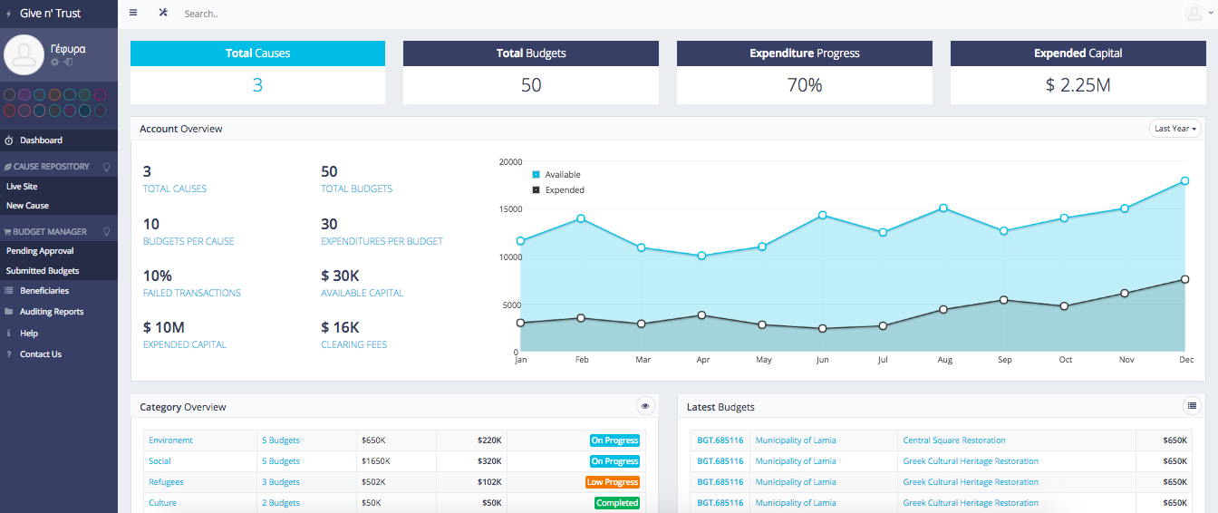

Slide 15
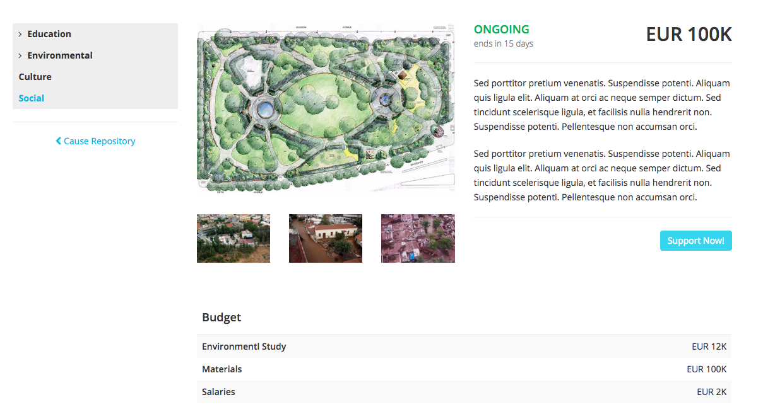

Slide 16
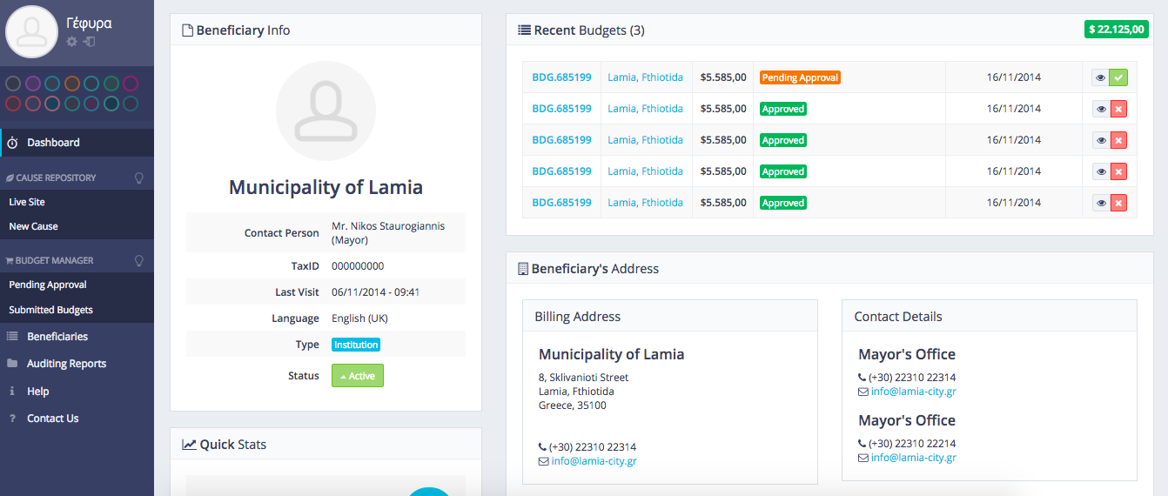

Slide 17
